Slide 1
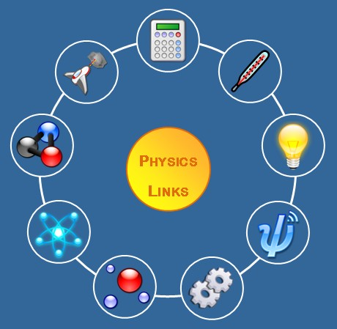
Introduction
NASC 3
Physics in Everyday Life
PHYSICS
http://www.physics.ox.ac.uk/pjcc/LINKS/new/normal.jpg

Slide 2
Have you tried these?

Slide 3
Have you tried these?

Slide 4
Have you tried these?

Slide 5
Have you tried these?

Slide 6
Have you tried these?

Slide 7
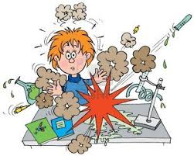
Science
systematized knowledge
systematic enterprise of gathering knowledge
www.123rf.com

Slide 8
Characteristics of Scientific Explanation
Empirical
objective & systematic observation
verifiable by others
Rational
follows rules of logic
consistent with known facts

Slide 9
Characteristics of Scientific Explanation
Testable
Measurable
specify prediction (falsifiable)
Tentative
confident but…
possibly wrong or limited

Slide 10
Characteristics of Scientific Explanation
Rigorously Evaluated
constantly evaluated
pitted against other explanation

Slide 11
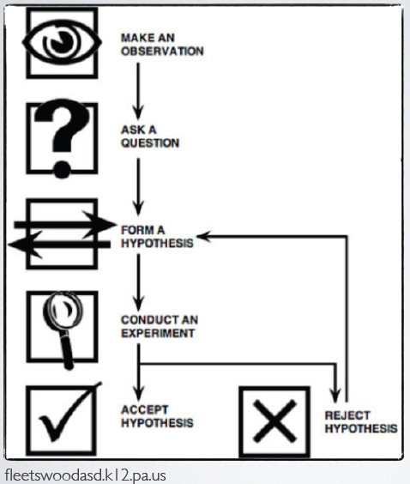
How does science work??
Complete the diagram

Slide 12
Scientific Methods
Make an observation
Ask a question
Formulate a hypothesis
Conduct an experiment
Analyze data and draw conclusion

Slide 13
Scientist must accept the results of their experiment even if they wish them to be different
They must learn to distinguish between what they see and what they wish to see
Hewitt, P.G. (1993). Conceptual Physics. Harper Collins College Publishers

Slide 14
In testing the hypothesis
Independent variable – What you change
Dependent variable – Responds to the experimental setup
Control – Something you do nothing to (something used to compare results)
www.123rf.com

Slide 15
THINK LIKE A SCIENTIST
Pick a question and design an experiment to answer the question in five minutes (1/4th sheet of paper)
Write the question on your piece of paper, along with your name, the date today and your RECIT SECTION

Slide 16
THINK LIKE A SCIENTIST
1. Do dogs prefer classical music over pop?
2. Will fish grow larger if placed in a larger tank?
3. Do people really prefer the taste of “buko pie A” over “buko pie B” or are they just letting the brand name affect them?

Slide 17
Do dogs prefer classical music over pop?
Observation: Dogs have sensitive sense of hearing.
Question: Do dogs prefer classical or pop music?
Hypothesis: Dogs prefer classical music because they have sensitive sense of hearing
K-C. L.S.C (B-6L)

Slide 18
Do dogs prefer classical music over pop?
Experiment: Two dogs with same breed, size and conditions will be put in two same separate rooms. Dog 1 will be put in room 1 with classical music and Dog 2 will be in room 2 with pop music
Independent variable: type of music
Dependent variable: the response/reaction of the dogs
Constants: dogs, rooms
K-C L.S.C (B-6L)

Slide 19
Mechanism for “Self-correction”
Expose ideas and results to independent testing → replication by other scientist.
Abandon and modify accepted conclusions when confronted with more complete or reliable experimental evidence.

Slide 20
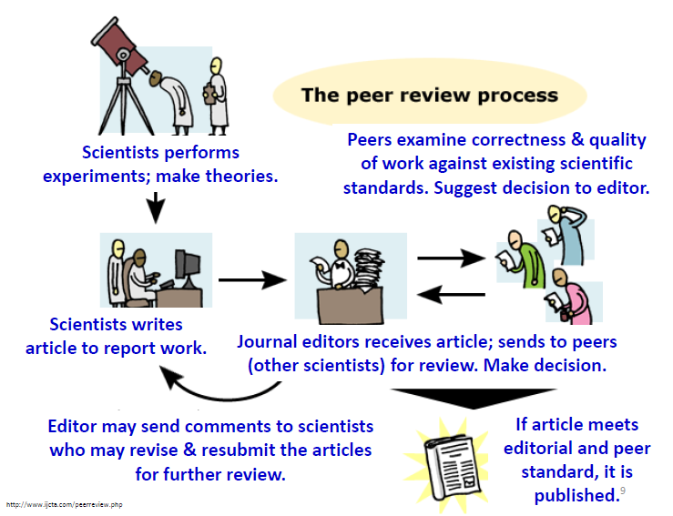
Peer review

Slide 21
Peer review
Peer
friend; an equal (neither a superior or a subordinate)
other scientists
Review
look again; examine
against accepted standards;
provide constructive criticism;
Decision:
accept; accept with conditions or reject

Slide 22

Scientific misconduct “FRAUD”
Violation of the standard codes of scholarly conduct and ethical behavior in professional scientific research
"Intention or gross negligence leading to fabrication of the scientific message or a false credit or emphasis given to a scientist"
http://en.wikipedia.org/wiki/Scientific_misconduct (and references therein)

Slide 23
Scientific misconduct “FRAUD”
Fabrication: making up results & recording or reporting them.
Falsification: manipulating research materials, equipment, or processes or changing or omitting data or results such that the research is not accurately represented in the research record.
http://en.wikipedia.org/wiki/Scientific_misconduct (and references therein)

Slide 24
Scientific misconduct “FRAUD”
Plagiarism: appropriation of another person’s ideas, processes, results, or words without giving appropriate credit.
Self-plagiarism: multiple publication of the same content with different titles and/or in different journals (is sometimes also considered misconduct).
http://en.wikipedia.org/wiki/Scientific_misconduct (and references therein)

Slide 25

Scientific misconduct “FRAUD”
Why would you do that???
Career pressure
Ease of fabrication!
But be aware :
A discredited scientist very rarely gets a second chance in the scientific community

Slide 26

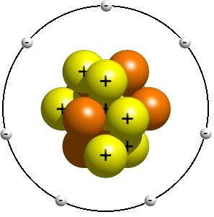

Models
mental image of a phenomena in terms of something we are familiar with.
www.sensoryedge.com
rantswithintheundeadgod.blogspot.com
logbase2.blogspot.com

Slide 27

Theories
an explanation of why something happens.
It comes from many observations and experiments. It can be changed with new data.
Evolves over time through redefinition and refinement

Slide 28
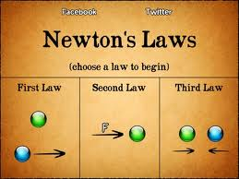
Laws
concise but general statements how nature behaves.
Usually takes the form of relationship equations

Slide 29
Physics
PHYSICS
“knowledge of nature”
derived from “physika” meaning “natural things”

Slide 30
What is Physics ?
Science that deals with matter and energy
Aim:
Matter and Energy
Describe
(empirical equations, models, etc. )
Understand
(laws and theories)

Slide 31
Why study Physics?
Physics, the most fundamental science, is concerned with the basic principles of the Universe.
It is the foundation upon which the other sciences - astronomy, biology, chemistry and geology – are based.

Slide 32
Classical Physics (< 20th century)
Mechanics – deals with motion, inertia, force at energy.
Thermodynamics – involves heat flow, heat transformations at temperature measurements
Electricity and Magnetism – deals with aspects of matter at space, emphasis on electric charge and electric current
Optics – nature and propagation of light

Slide 33
Modern Physics (≥20th century)
Modern Physics – extension of physics at the atomic and macroscopic level.
Relativity
Quantum Mechanics
Condensed-matter physics
Nuclear physics
Astrophysics

